Slide 1
Beja ShrineRS: Family Fun -- All Year Long!

Slide 2
Welcome to Beja ShrineRS!
At Beja, family, fun, and community are at the heart of everything we do! Whether you’re a longtime friend or visiting for the first time, we invite you to be part of an exciting year filled with memorable events, meaningful connections, and making a difference together.
Join us for the fun—because at Beja, you’re always family!

Slide 3
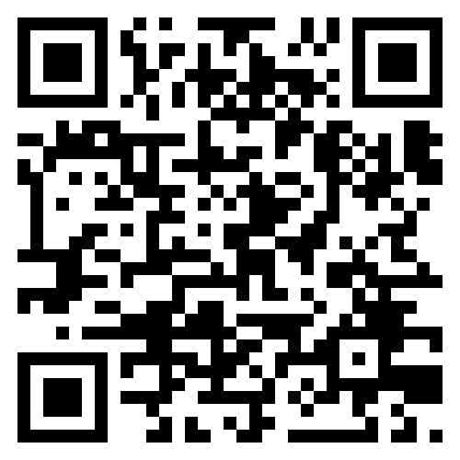
📲 Stay Connected With Beja Shriners On Facebook!
🔹 Follow us for: ✅ Event Updates & Announcements ✅ Community Impact Stories ✅ Fun Photos & Behind-the-Scenes Moments
📸 Scan the QR Code to Like & Follow Us!

Slide 4
Ladies and Gentlemen, Children of All Ages! Come to the Beja Shrine Circus!
4
May 17 & 18, 2025 – Resch Center
Saturday: 11:00 – 3:00 – 7:00
Sunday: 1:00 & 5:00

Slide 5
Experience The Thrill Of The Circus!
Amazing acts,
exciting entertainment,
and fun for all ages

Slide 6
🚩 Golf for Good: Two Ways To Give Back While Enjoying The Game
⛳ Supporting Charity, Building Community—One Swing at a Time!

Slide 7
🏌️‍♂️ Teeing Off for a Cause: Two Golf Outings, One Mission!
Tues, July 15th @ Royal St Patricks’ Golf Links, Wrightstown
Benefits Beja Shriners’ Transportation Fund Open to all skill levels – fun, fellowship, and fundraising
Saturday, September 6th @ Maxwelton Braes, Baileys Harbor
Benefits Daughters of the Nile Charities
Welcoming participants of all levels

Slide 8
A Holiday Wonderland
Feztival of Trees
8
November 26th, 28th, & 29th
Here at the Shrine Center

Slide 9
Celebrate The Holiday Season At The Beja Shrine Feztival Of Trees!
A magical display of decorated trees, wreaths, and holiday cheer

Slide 10
Santa's Coming to Town!
10
Saturday, December 6, 2025
8:30 – 11:00 am

Slide 11
Enjoy A Festive Breakfast Buffet And Meet Santa Claus! A Perfect Way To Kick Off The Holiday Season.

Slide 12
🐰 Join Us Again Next Year For More Fun! 🌸
12
Date: March 29, 2026
Time: 8:30 – 11:00 am

Slide 13
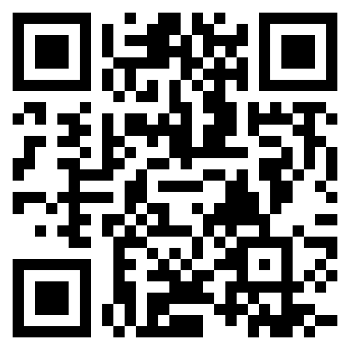
🎩 Thank You for Your Support! 🎩 🙏 We Appreciate You & Look Forward to Seeing You Again! 📲 Stay Connected: 📍 Beja Shriners – 1950 Bond St, Green Bay 📞 (920) 498-1985 | ✉️ bejashrine@new.rr.com
🌐 Scan the QR Code to Visit Our Website!
🔗 Follow Us on Social Media for Updates & Events!

